Slide 1
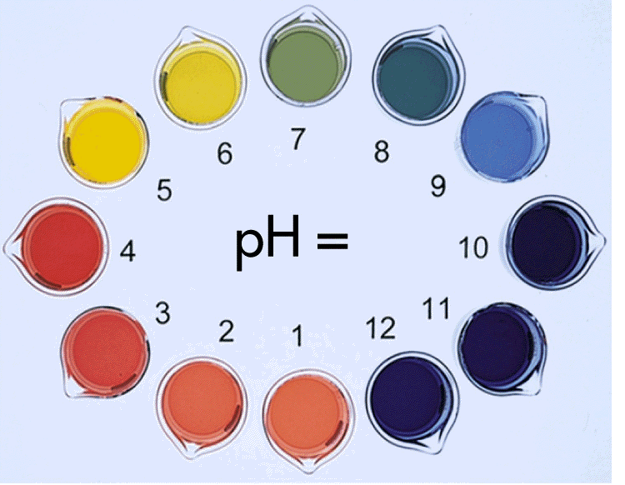
Acids, Bases and Water!
Chapter 19 (mostly)

Slide 2
Acids, Bases, & Salts
Electrolytes – conduct an electric current
Three Theories of Acids & Bases
**KNOW THESE 3**
Arrhenius Theory – (only in H₂O)
Acids: produce H⁺ in H₂O
HCl → H⁺ + Cl – (H⁺ actually H₃O⁺)
Bases: produce OH – in H₂O
NaOH → Na⁺ + OH –
Brønsted-Lowry Theory –
Acids: substance that donates a proton
Bases: substance that accepts a proton
NH₃ + H₂O → NH₄⁺ + OH–
(base) (acid) (H+)
Lewis Theory –
Acids: electron pair acceptor
Bases: electron pair donor
H⁺ + – OH → H₂O
^{(acid) (base)}

Slide 3
Acids, Bases, & Salts
Conjugate acid base pairs (based on the Brønsted-Lowry Theory)
Conjugate Acid-
The particle formed when a base gains a hydrogen ion
Conjugate Base-
The particle that remains when an acid has donated a hydrogen ion
NH₃ + H₂O → NH₄⁺ + OH–
^{base acid}
HCl + H₂O → H₃O ⁺ + Cl –
^{Conjugate acid}
^{Conjugate base}

Slide 4
Amphoteric: a substance that can react as either an acid or a base
-Water is most common
Ex. HCl + H₂O → H₃O ⁺ + Cl – (base accepts H⁺)
^{(base)}
Ex. NH₃ + H₂O → NH₄⁺ + OH – (acid donates H⁺)
^{(acid)}
Salt – a crystalline compound composed of the negative ion of an acid and the positive ion of a base
Salts are the product of a neutralization reaction:
Acid + Base → Salt + Water
HCl + NaOH → NaCl + HOH
^{(acid) (base)} ^{(salt) (water)}

Slide 5
What type of reaction is below?
Pick out the acid, base, and salt in the following reaction:
HF + Ba(OH)₂ → BaF₂ + H₂O
Strength of Acids & Bases
Strong (acid or base) – completely ionizes in solution
Weak (acid or base) – doesn’t completely ionize
HCl + H₂O → *H₃O⁺ + Cl – (completely ionized)
^{(completely in this form)}
HC₂H₃O₂ + H₂O ↔ *H₃O⁺ + C₂H₃O₂ – (not completely
^{(some in both forms)} ionized)
*This is called a hydronium ion. It’s what happens when H⁺ ions are in water. They are basically synonymous with H⁺ ions.
Completely ionized = strong acid
Not completely ionize = weak acid

Slide 6
Types of Acids (Based on the Arrhenius definition)
Monoprotic – acid that can donate one proton (hydrogen
ion) per molecule (HCl)
Diprotic – acid that can donate two protons per molecule
(H₂SO₄)
Triprotic – acid that can donate three protons per molecule
(H₃PO₄)
Polyprotic – acid that can donate more than one proton
What about these?
H₂S HF H₃PO₃ HClO₃
General Properties of Acids
1. Sour taste
2. Contains hydrogen
3. Change color of dyes in acid/base indicators
4. React with bases to produce salt and water
5. Are electrolytes
General Properties of Bases
1. Bitter taste
2. Feels slippery to the skin
3. Usually contains OH
4. Change color of dyes in acid/base indicators
5. React with acids to produce salt and water
6. Are electrolytes

Slide 7
Concept of pH
pH scale*** – measures the concentration of hydronium ions (H⁺/H₃O⁺) in solution
HCl – strong acid (strong electrolyte)
Grapefruit – weak acid (weak electrolyte)
NaOH – strong base (strong electrolyte)
Milk of Magnesia – weak base (weak electrolyte)
***pH scale is a logarithmic scale, meaning that is increases by powers of 10. So if something has a pH of 2, something that has a pH of 1 is NOT twice as acidic, but rather 10 times more acidic

Slide 8
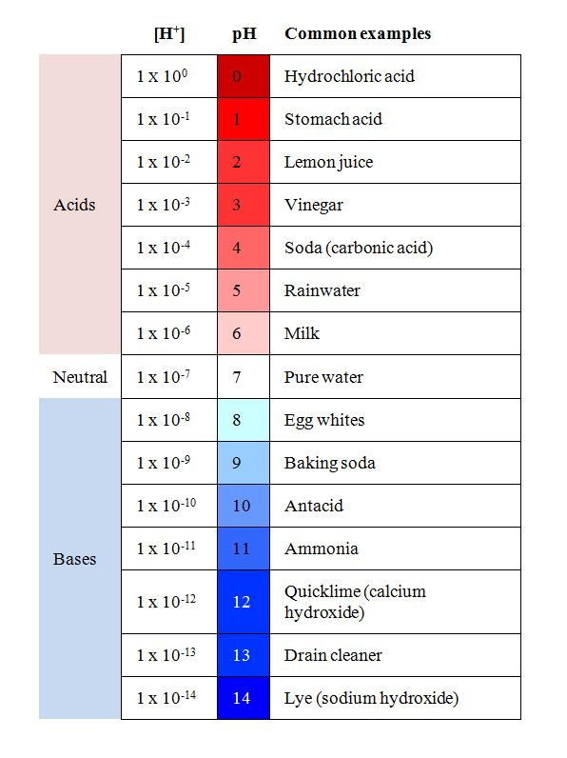
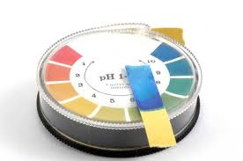
Common Acid and Base pH levels
INDICATORS-
Can tell us the pH of a substance
Indigestion problems?

Slide 9
Determine the pH
pH – measures the concentration of hydronium ions [H⁺/H₃O⁺] in solution
Format:
[H⁺] = 1.00 x 10^{-X}M
(if number in blue is 1)pH = X
The measure of the hydronium ion concentration
pH = -log [H⁺]
Find the pH from the following [H⁺] concentration
1.00 x 10⁻³M
3
1.00 x 10⁻¹⁰M
10
Acidic? Basic? Neutral?

Slide 10
Determine the pOH
pOH - measures the concentration of hydroxide ions (OH⁻) in solution
Format:
[OH⁻] = 1.00 x 10^{-X}M
(if number in blue is 1) pOH = X
pOH = -log [OH⁻]
Find the pOH from the following [OH⁻] concentrations
1.00 x 10⁻³M
3
1.00 x 10⁻¹⁰M
10
**The reverse calculation?**

Slide 11
pH and pOH
From the Kw equation we can determine that:
pH + pOH = 14
If the pH of a citric acid solution is 3.7, what is the pOH?
14 – 3.7 = 10.3
pOH = 10.3
If the pOH of a solution is 6.8 what is the pH of that same solution?
14 - 6.8 = 7.2
pH = 7.2
Acidic? Basic? Neutral? (always in terms of pH)

Slide 12
Using Ion concentration to determine acidity
If [H⁺] > [OH⁻] than the resulting solution is acidic
If [H⁺] < [OH⁻] than the resulting solution is basic
If Coca cola has an [H⁺] = 1.0 x 10⁻⁵ M, is the solution acidic, basic or neutral? What is the [OH⁻] of the solution?

Slide 13
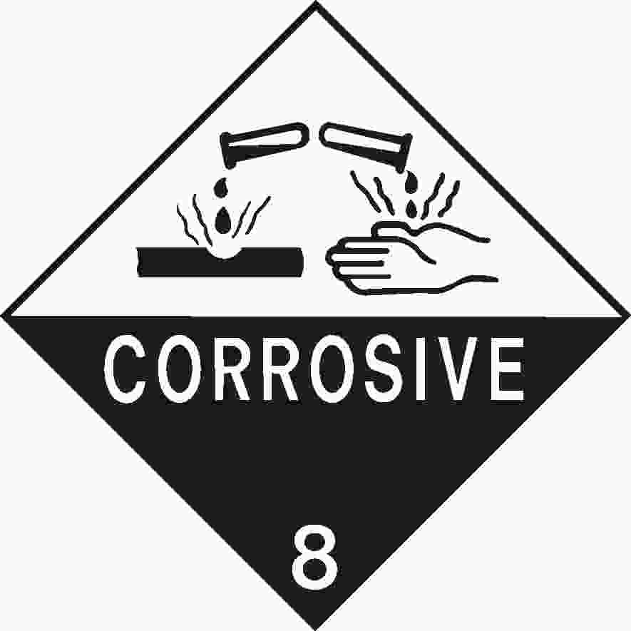
Acid Nomenclature (review)
A. Binary Acid (2 elements)
hydro____ic
HBr – Hydrobromic Acid
HCl – Hydrochloric Acid
HF – Hydrofluoric Acid
Are these monoprotic, diprotic, or triprotic acids?

Slide 14
Acid Nomenclature (Naming!)
B. Oxyacids or Ternary Acids
Acid Name
HClO₄ perchloric acid
HClO₃ chloric acid
HClO₂ chlorous acid
HClO hypochlorous acid
Ion Name
ClO₄ – perchlorate
ClO₃ – chlorate
ClO₂ – chlorite
ClO – hypochlorite
Note: ate => ic
ite => ous

Slide 15
Practice
p. 593-604
#3-6, 7a, 8-10, 18, 20, 21

Slide 16
Titration p.613
What is titration?
What is the end point?
What is the equivalence point?
Why is the endpoint significant in terms of your procedure for a lab?

Slide 17
Calculating the Molarity of an Acid
Neutralization Reaction (Monoprotic)
Acids and bases produce salt and water
HCl + NaOH → NaCl + H₂O
Same as before!
(#H⁺) x M_{a} x V_{a} = M_{b} x V_{b} x (#OH⁻)
15mL of HCl is mixed with 10mL of Ba(OH)₂ which has a molarity of 3.0 M and completely neutralized. What is the molarity of the acid solution?
(1) x M₁ x 15mL = 10mL x 3.0M x (2) M₁ = 4.0M

Slide 18
Titration Practice
p.616-625
#32-35 & 65

Slide 19
Lab Prep
Titration Problem:
A student performs a titration using 0.117 M HCl. The initial reading on the acid buret is 3.12 mL and the final reading is 18.65 mL. The initial reading on the base buret is 10.60 mL and final reading is 24.90 mL. What is the molarity of the sodium hydroxide?
Acid 0.117 M HCl Base ______ M
________ Vf _______ Vf
- ________ Vi - ______ Vi
------------------- ---------------------
_______ mL acid ______ mL base

